Slide 1

OKRs Unleashed: Supercharging Threat Modeling Effectiveness

Slide 2
Agenda
01 – Introducing OKRs
03
02 – Threat Modeling Maturity Model
06
03 – OKRs where you are
07
Notes:
Before we get into the presentation for today…
I want to get a sense of where everyone is with regard to threat model
WHo is in here has a full time or part time role in threat modeling in your organization?
OKay, of those who are, how many have defined threat modeling organization strategies and can articulate that vision clearly?
Warning, you are going to hear me talk about ROI alot.

Slide 3

“An Objective is simply what is to be accomplished. It should be a crisp, one-line statement that is meaningful, action-oriented, and, ideally, inspirational.”
Notes:
I have gotten some stiff resistant to OKRs
OKRs are just a way to tie together a strategic objectives with a clear set of measurable steps or outcomes needed to achieve that goal

Slide 4
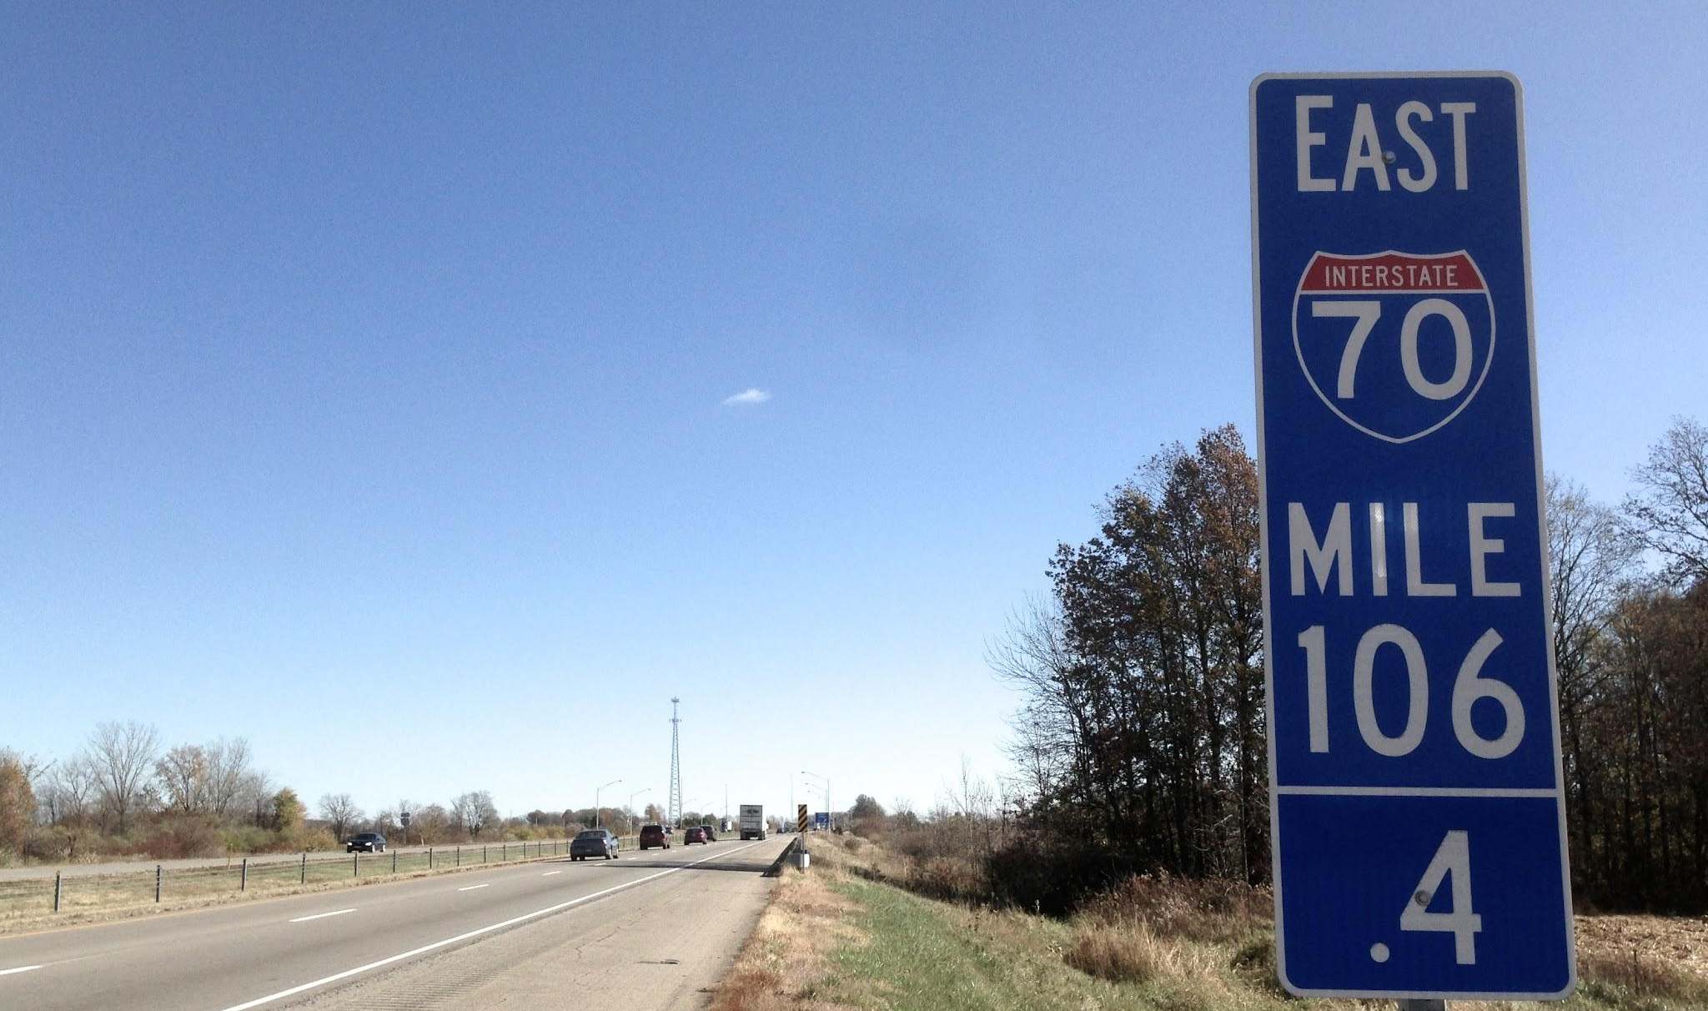
“Key Results should be specific and time-bound. They should be measurable and able to be assigned a grade at the end of the OKR cycle.”

Slide 5
Key Results can be rejected or rewritten as new information becomes available.

Slide 6
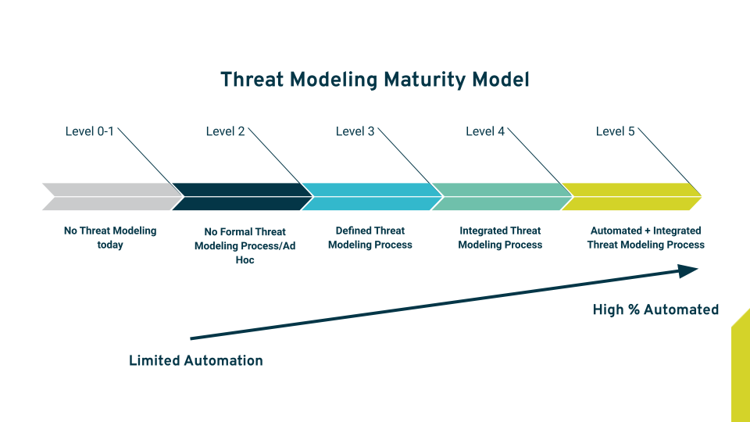
Threat
Modeling Program Maturity
Simple model that focuses on Process, Integration, and Automation
Notes:
The main goal of today’s presentation is to provide something useful for your threat modeling program regardless of where you are.
When we talk about threat modeling perspectives its important to get a good understanding of where the organization is and where it might be headed next
This model is organized according to ROI drivers for threat modeling and secure application development
For the remainder of today’s session, we are going to talk in the following format - discuss OKRs at each maturity level and introduce some kpis that might be valuable.

Slide 7
Threat Modeling Program Maturity
Level 1
No Threat Modeling is being done >>> Adhoc Threat Modeling
Objective
Start creating threat models for new systems prior to any code or systems changes
Key Results
Organization has provided 2 hours of threat modeling training to end users by end of March
Organization has created a single bad threat model by end of March
KPIs - Threat Models Created, Trained Users (net)
Notes:
SO I am a Level 1 organization seeking to be a Level 2 organization

Slide 8
Threat Model Value
Threat Models
Threats
Value
What is the actual value of a threat model?
Value = Returns - Costs
Countermeasures
Reduced Risk
Notes:
As we are starting the process of creating a threat modeling program it is important to focus on the real value of threat modeling.

Slide 9

HIGH ROI Threat Models
Relevant Scope
Prioritized Threats
Prioritized Countermeasures
Reduced Risk
Notes:
SMART measurements
Specific
Measurable
Achievable
Relevant
Timely

Slide 10
Threat Modeling Program Maturity
Level 2
Adhoc Threat Modeling >>> Defined Threat Modeling Process
Objective
Create a systematic process that produces a consistently acceptable threat model.
Key Results
Threat Modeling process is defined, documented, and taught to relevant stakeholders
All v1 threat models are completed in 8 hours or less
KPIs - Avg Threat Model Time (in stages), Threat Model Qty, Threat models per SDLC stage
Notes:
I am am a level 2 organization seeking to be a level 3 organization

Slide 11
HIGH ROI Process
Shift Left
Secure by Default
Net Security Change vs perfect representation
Notes:
SMART measurements
Specific
Measurable
Achievable
Relevant
Timely

Slide 12
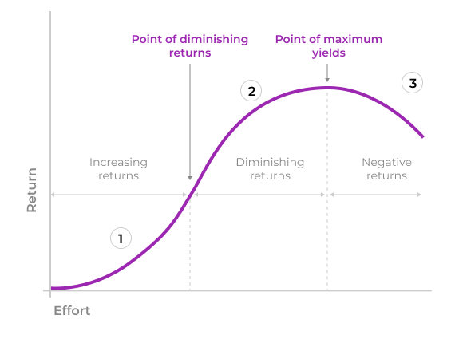
Diminished Marginal Returns
As the effort to create value (net return) increases the net value of the return is diminished over time.
Don’t read the fine print - Image liberated from https://uxmag.com/articles/law-of-diminishing-returns-design-and-decision-making
Notes:
SMART measurements
Specific
Measurable
Achievable
Relevant
Timely

Slide 13
Diminished Marginal Returns
Way too accurate
Full System Representation
As the effort to create value (net return) increases the net value of the return is diminished over time.
Net Security Change
Don’t read the fine print - Image liberated from https://uxmag.com/articles/law-of-diminishing-returns-design-and-decision-making
Notes:
SMART measurements
Specific
Measurable
Achievable
Relevant
Timely

Slide 14
Threat Modeling Program Maturity
Level 3
Defined Threat Modeling Process >>> Integrated Threat Modeling Process
Objective
Defined process is integrated across the organization
Key Results
Integration points are documented and prioritized by end of Q1
Change management plan is documented and disseminated to all stakeholders by end of Q2
KPIs - Security Champions, Improvement Plan Existence

Slide 15
HIGH ROI Integrations
Governance Risk Management & Compliance
Architectural Review
Notes:
SMART measurements
Specific
Measurable
Achievable
Relevant
Timely

Slide 16
Threat Modeling Program Maturity
Level 4
Integrated Threat Modeling Process >>> Automated Threat Modeling Process
Objective
Business integrated process is sustained and scaled through automation
Key Results
All net IaC changes are analyzed and threat modeled by end of Q3
Manual translation of information has been reduced by 50% by end of Q3
KPIs - Automated Threat Models, Issues created by automation, dashboards vs manual reporting

Slide 17
HIGH ROI Automation
Issue Tracker Integration
Standardized Threats
Automated Actioning
Template driven threat models
Notes:
SMART measurements
Specific
Measurable
Achievable
Relevant
Timely

Slide 18
Scenario
Organization needs to improve the overall efficiency and effectiveness of its threat modeling program.

Slide 19
Sample OKR
Objective - Grow threat modeling value per threat model
Key Result 1 - Achieve a 4 hour threat model across all v1 projects by implementing time blocking processes by end of Q2
Key Result 2 - All v2 projects are completed within an additional 2 hours by end of Q3

Slide 20
Scenario
Organization has a diverse group of threat modeling practitioners operating independently with wide variances in process, tooling, and outputs.

Slide 21
Sample OKR
Objective - Enhance Threat Modeling Process Efficiency
Key Result 1 - Achieve a 30% reduction in the time required for threat modeling activities across all projects by implementing standardized automation tools and processes by end of Q2
Key Result 2 - Increase the number of threat models completed per quarter by 20% through streamlined workflows and automation
Key Result 3 - Conduct a training program for development and security teams, resulting in a 50% training completion in threat modeling best practices by end of year

Slide 22
Scenario
Organization has a MATURE and business INTEGRATED threat modeling process that is further sustained by a threat modeling product.

Slide 23
Sample OKR
Objective - Strengthen Collaboration between Development and Security Teams
Key Result 1 - Facilitate cross-functional workshops between development and security teams, resulting in a 40% increase in collaborative threat modeling sessions by end of May.
Key Result 2 - Implement a feedback mechanism to address identified threats, aiming for a 50% reduction in the time taken to remediate critical issues by end of year.
Key Result 3 - Establish a regular communication channel between security and development teams, leading to a 30% improvement in information sharing related to emerging threats and vulnerabilities.

Slide 24
Scenario
Organization is NEW to FORMAL threat modeling and does not have a well defined process.

Slide 25
Sample OKR
Objective - Standardize Threat Modeling Practices
Key Result 1 - Establish a standardized threat modeling framework and documentation for all development teams, resulting in a 95% adherence to best practices.
Key Result 2 - Conduct regular reviews to ensure consistency in threat modeling outputs, with a goal of reducing variations by 80% across different projects
Key Result 3 - Develop and implement a metrics dashboard by end of month to track and report on threat modeling progress, ensuring visibility and accountability at all levels.

Slide 26

Why KPIs?
KPIs provide valuable point in time data into the pending success or failure of a process.

Slide 27

Sample Process KPIs
Adherence to Standardized Practices
Process incidents (failure indicator)
Percentage of Projects with Integrated Automation
Tickets created by integrations vs manual effort (trending indicators)
Feedback loop effectiveness
New Secure by default standards deployed from Threat Modeling process (success indicator)
Qty of Threats Created manually vs automatically

Slide 28

Sample Financial KPIs
Threat Model Review Cycle Time
How long does it take to complete a threat model (Time/Required CM) and (Time/Implemented CM)
Number of Threats Discovered Post-Release
Remediation Time for Critical Threats
Cost of Security Incidents

Slide 29

Sample Value KPIs
Number of Threat Models Created
Production Threat Models vs Pre-Production
Requires a description of done
Quantity of High Priority Prioritized Actionable Threats
Number of Threats Discovered Pre & Post-Release
Quantity of High Value Prioritized Actionable Countermeasures
Percentage of High-Risk Threats Mitigated

Slide 30
Questions?

